Slide 1
MULTITYPE FRAUD DETECTION IN E-COMMERCE TRANSACTIONS USING MACHINE LEARNING

Slide 2
ABSTRACT
E-commerce platforms have witnessed rapid growth in recent years, accompanied by a significant rise in fraudulent activities across multiple categories such as payment fraud, identity theft, refund fraud, promotion abuse, account takeover, and synthetic account creation. Traditional rule-based and single-model fraud detection systems struggle to keep pace with evolving fraud patterns, resulting in reduced accuracy and high false-positive rates. This project presents a machine-learning-based multitype fraud detection framework that integrates advanced classification algorithms to improve fraud identification in digital transactions. The system utilizes Random Forest as the existing baseline model and implements XGBoost and a stacking ensemble as enhanced detection mechanisms. The workflow includes dataset uploading, preprocessing, feature encoding, model training, evaluation, and real-time fraud prediction through a Django-based interface. Experimental results demonstrate that XGBoost and stacking classifiers outperform the baseline model in precision, recall, and overall detection accuracy, particularly for minority fraud classes. The proposed system provides a scalable, robust, and intelligent fraud detection solution capable of effectively identifying diverse fraud types and enhancing security in modern e-commerce environments.

Slide 3
Introduction
E-commerce has grown rapidly, leading to an increase in fraudulent activities.
Fraud occurs in multiple forms: payment fraud, identity theft, account takeover, promotion abuse, refund fraud, etc.
Traditional systems fail due to evolving patterns and high false positives.
Machine Learning provides scalable, accurate, and automated fraud detection.
This project develops a multi-type fraud detection system using ML models.

Slide 4
Problem Statement
Existing fraud detection systems cannot adapt to multiple fraud categories.
Imbalanced datasets make it difficult to detect small but critical fraud classes.
Rule-based and basic ML models like Random Forest often misclassify complex patterns.
Manual fraud verification is slow and inefficient.
Need for a scalable, accurate, automatic multi-type fraud detection system.

Slide 5
Objectives
Detect multiple types of e-commerce fraud using ML algorithms.
Compare performance of Random Forest (existing system) and XGBoost (proposed system).
Implement stacking classifier for improved predictions.
Allow users to test transactions through a prediction interface.
Build full pipeline: upload → preprocess → train → evaluate → predict.

Slide 6
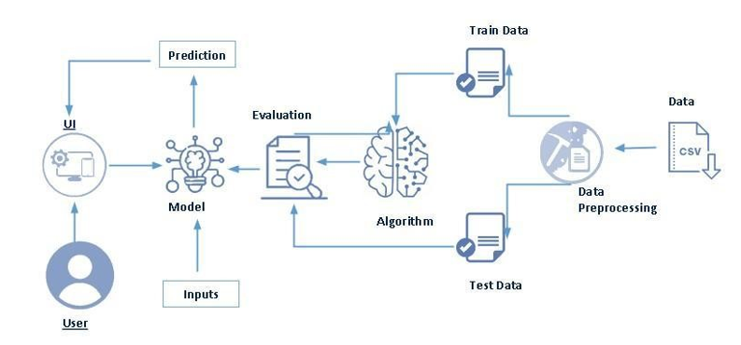
System Architecture

Slide 7
Dataset Upload
Data Preprocessing
Train/Test Split
ML Training (XGBoost, Random Forest, Stacking)
Model Saving and Loading
User Input & Manual Encoding
Fraud Prediction Output
Django-based UI across admin and user levels

Slide 8
Modules
1. Authentication Module — Admin & User login
2. Dataset Module — Upload and load CSV
3. Preprocessing Module — Clean, encode, visualize
4. Split Module — Train/Test division
5. Training Module — XGBoost & Stacking
6. Metrics Module — Accuracy, Precision, Recall, F1, Confusion Matrix
7. Prediction Module — Input form + fraud classification
8. Utility Module — Label mapping, model storage

Slide 9
Existing System
The existing fraud detection system relies primarily on the Random Forest algorithm, which functions as a baseline machine learning model for classifying e-commerce transactions. Random Forest combines multiple decision trees to reduce variance and improve prediction stability. While it performs reasonably well on structured tabular data, its effectiveness decreases when handling highly imbalanced datasets, where fraudulent transactions form only a small portion of the data. The model lacks the boosting mechanism required to refine weak learners, making it less capable of detecting rare and complex fraud categories such as synthetic accounts, promotion abuse, and identity theft. Additionally, Random Forest does not adapt efficiently to evolving fraud patterns and often results in higher false positives and false negatives. Due to these limitations, the existing system struggles to provide accurate multi-type fraud classification in dynamic e-commerce environments.

Slide 10
Proposed System
The proposed system introduces a more advanced and scalable fraud detection approach using XGBoost and an optional stacking ensemble model. XGBoost (Extreme Gradient Boosting) improves classification accuracy by training trees sequentially, where each new tree corrects the errors of previous ones. It handles non-linear patterns, noisy features, and imbalanced data more effectively than Random Forest. The system further incorporates statistical anomaly handling and manual feature encoding, ensuring consistent preprocessing across training and real-time predictions. A stacking classifier, combining XGBoost, Random Forest, and Decision Tree with Logistic Regression as the meta-learner, enhances model robustness and multi-type detection capability. The proposed system significantly improves precision, recall, and F1-score across all fraud categories, including rare ones. This results in a reliable, intelligent, and adaptive solution suitable for large-scale, real-time fraud detection in e-commerce platforms.

Slide 11
Conclusion
The proposed multitype fraud detection system effectively enhances the accuracy, reliability, and scalability of identifying fraudulent activities within e-commerce transactions. By overcoming the limitations of the existing Random Forest model, the integration of advanced algorithms such as XGBoost and the stacking ensemble significantly improves the classification performance across diverse fraud categories. The system’s end-to-end workflow—covering dataset upload, preprocessing, model training, evaluation, and real-time prediction—ensures a practical and automated approach to fraud detection. Experimental results demonstrate superior precision, recall, and F1-scores for the proposed models, particularly in detecting rare and complex fraud types. The incorporation of statistical handling, feature engineering, and a user-friendly interface further strengthens the model’s applicability in real-world e-commerce environments. Overall, this project delivers a robust and intelligent fraud detection framework capable of adapting to evolving fraud patterns and providing strong protection for digital marketplaces.

